Slide 1
Stage G – Cordilleran-Type Orogeny
Notes:
And now for the penultimate stage – Cordilleran-Type mountain building.

Slide 2
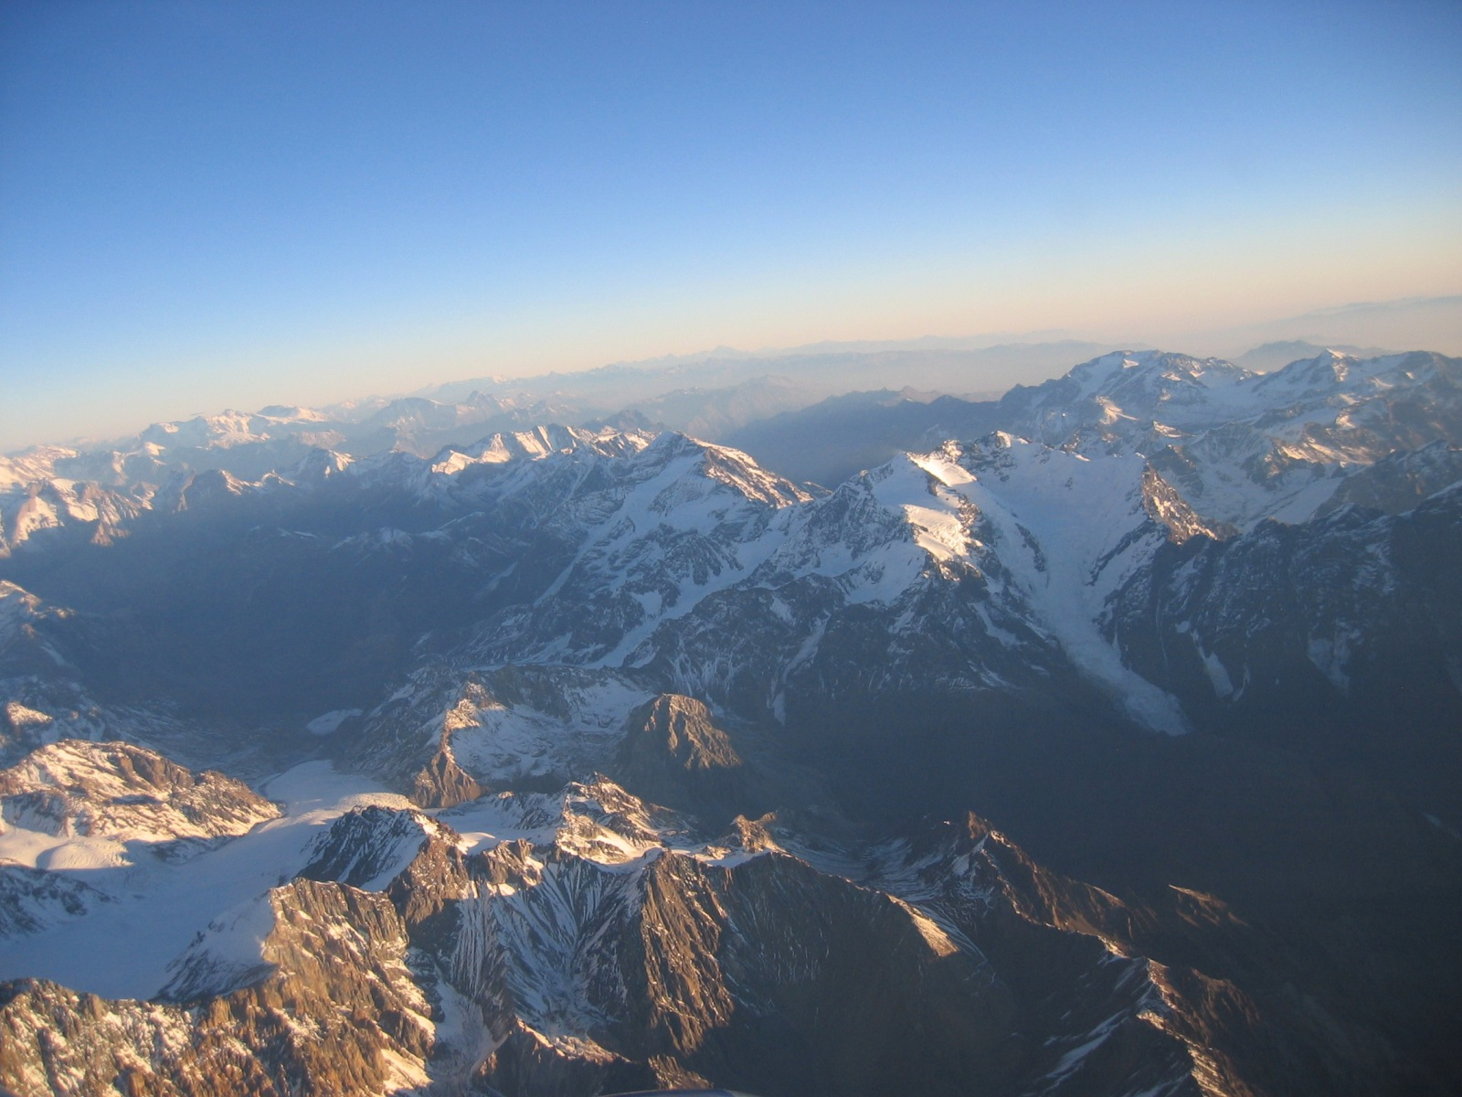
Notes:
Cordillera refers to a very long range of mountains. The Andes are a good example.

Slide 3
Notes:
The Andes were formed by the subduction of oceanic lithosphere beneath a continent.

Slide 4
Notes:
Many of the elements seen in ocean to ocean convergence (island arc type orogeny) are also seen in ocean to continent convergence (Cordilleran type orogeny). Let’s see if you can identify them. What’s this? …

Slide 5
trench
Notes:
Yep, that’s a trench.

Slide 6
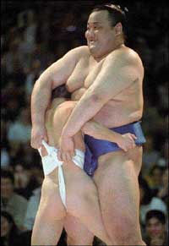
Notes:
Now let’s try one that’s a little harder. I’ve given you a hint.

Slide 7
Accretionary wedge
Notes:
… that’s right! It’s an accretionary wedge.

Slide 8
Notes:
Ok, now for the hardest one.

Slide 9
forearc basin
Notes:
If you picked forearc basin, give yourself a reward, because you’re doing really well! By the way, what kind of sediments would deposit here? Note the nearby volcanism.

Slide 10
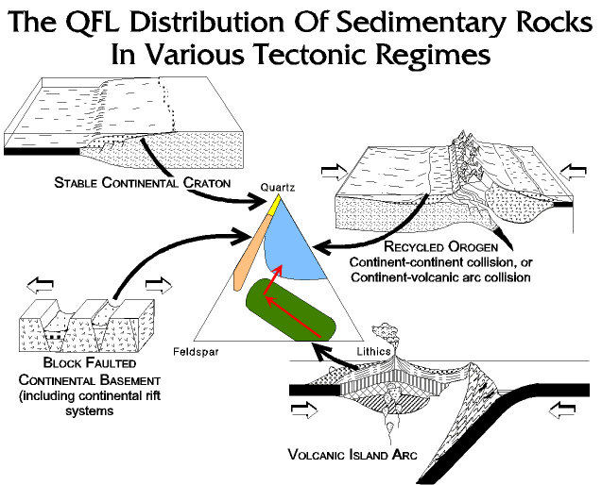
Notes:
Yah, there would probably be a lot of lithics, but because the volcanoes are emplaced within a DCM, sediment sources would be more variable than for an island arc.

Slide 11
Thrust faults
Notes:
Mountain building is only in part due to volcano growth. Compression produces thrust faults and further uplift.

Slide 12
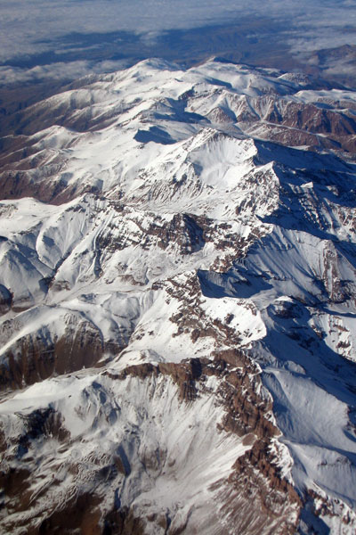
Notes:
Most of the mountains in the Andes are not volcanic. The uplift is mostly due to thrust faulting.

Slide 13
melting
Notes:
Magma formation is similar to that in island arc type orogeny. So what kind of melting happens here - wet melting or decompression melting?

Slide 14
Wet melting
Notes:
Did you guess wet melting? Then punish or reward yourself appropriately. Any time oceanic lithosphere is subducted sea water is carried into the mantle, and that causes wet melting.

Slide 15
Process?
Notes:
Ok now, when a mafic magma becomes more felsic by separating the low-melting point, high-silica minerals from the high-melting point, low-silica minerals, what is this process called?

Slide 16
Fractionation
Notes:
It’s fractionation, but partial melting or magmatic differentiation are correct too.

Slide 17
Type of magmatism?
Notes:
Ok, now what type of magma forms over subduction zones – ultramafic, mafic, intermediate or felsic?

Slide 18
Intermediate magmatism
Notes:
The magmas will be intermediate. If you got that right, then you are really beginning to catch on! As you have seen, subduction beneath continental lithosphere produces very similar processes and products to subduction beneath oceanic lithosphere. However, there are a few important differences. First, because continental crust is much thicker than oceanic crust, much more of the intermediate magma will get stuck within the continent, which means more plutonic rocks like diorite, and less volcanic rocks like andesite.

Slide 19
Volcanic arc
Notes:
Second, because the arc of volcanoes is formed on continental crust, they will not form islands. We’ll still get a volcanic arc. It just won’t be a volcanic island arc.

Slide 20
thick DCM sediments
Notes:
And one more difference… with Cordilleran orogeny, there will be the thick pile of DCM sediments to consider that did not exist in the island arc situation.

Slide 21
Metamorphism (Barrovian)
Notes:
The Barrovian metamorphism (remember that means both higher pressures and temperatures with depth) which accompanies subduction orogenies, will now metamorphose those DCM sediments in addition to the volcanic and plutonic rocks.

Slide 22
Backarc spreading
Notes:
In some situations, spreading can occur behind the volcanic arc. We will discuss backarc spreading at a later time.

Slide 23
peneplane
Notes:
Meanwhile the mountains produced by continent - island arc orogeny have a chance to wear down to a peneplane - a broad, nearly level surface, not much higher than sea level.

Slide 24
Stage H: Continent-Continent Collision
Notes:
And now for the grand finale! We build a new supercontinent by continent-continent collision.

Slide 25
Notes:
Continent-continent collision is sometimes called a “hard” collision.

Slide 26
hinterland
foreland
Notes:
As with all collision orogenies, there will be a foreland, hinterland and

Slide 27
Suture zone
Notes:
… suture zone where they meet.

Slide 28
Notes:
Let’s look at this diagram from the opposite direction so we can better compare it with …

Slide 29
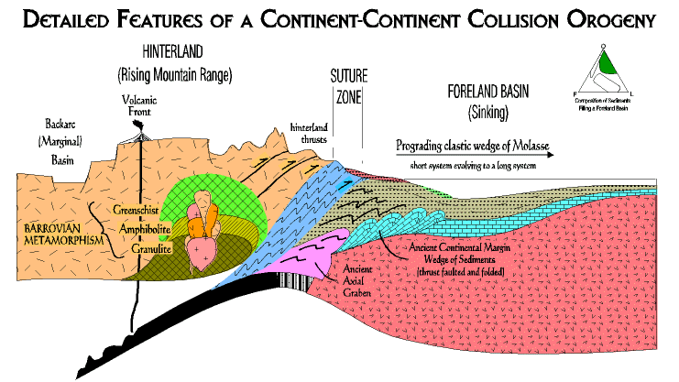
Notes:
… this more detailed diagram of a continent-continent collision orogeny. You’ll notice many of the same features that we saw in continent-island arc collision. There some important differences, however. Here, both hinterland and foreland bring DCM sediments into the collision zone. Since those of the hinterland were subjected to Barrovian metamorphism the suture zone here is comprised of a more complex mix of rock types than in continent-island arc orogeny.

Slide 30
Hinterland thrusts
Notes:
Also different here is the severity of hinterland thrusting due to the much “harder” collision between two continents. Think of continent-island arc orogeny as analogous to a head-on collision between a Mack truck and a Volkswagen, whereas continent-continent orogeny involves two Mack trucks.

Slide 31
Foreland basin
Notes:
An impressive foreland basin will form …

Slide 32
Deformed DCM sediments
Notes:
… over deformed foreland DCM sediments.

Slide 33
Notes:
These will be buried by …

Slide 34
Notes:
… a clastic wedge derived from the collision-formed mountains. The style of deposition changes…

Slide 35
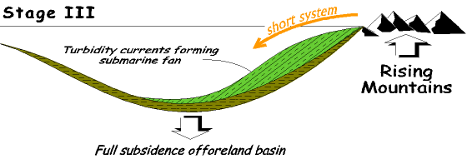
Notes:
... over time….

Slide 36
Notes:
… but eventually…

Slide 37
Notes:
… the entire foreland basin is filled, as all the mountains are worn down, …

Slide 38
peneplane
Notes:
… a vast peneplane develops, and …

Slide 39
Stage I – Stable Continental Craton
Notes:
… a new stable continental craton emerges to start the cycle again.

Slide 40
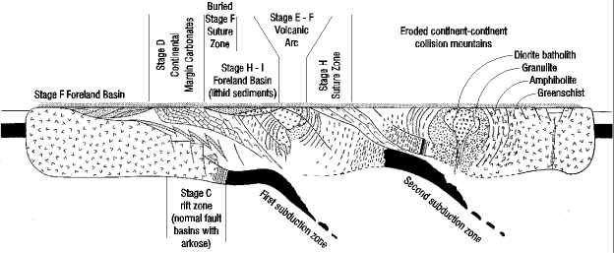
Notes:
Wow!! If you made it through all that and you can pick out all the elements of the various Wilson Cycle stages within the craton, you are doing amazingly well! You’ve got a really good idea how the earth works on the large scale and nothing in this course should be beyond your understanding. If you didn’t get all that, please know that we will cover this information again and again as we see how individual parks fit into the context of the Wilson Cycle. Nothing in this class is more difficult than the Wilson Cycle, but nothing here is more central to understanding.

